Slide 1
Employee Data Analysis using Excel
STUDENT NAME: JAYAPRATHA.J
REGISTER NO:312216775
DEPARTMENT:BCOM(ACCOUNTING AND FINANCE)
COLLEGE: SHRI KRISHNASWAMY COLLEGE FOR WOMEN

Slide 2
PROJECT TITLE
Human resource Analysis using Excel

Slide 3


AGENDA
Problem Statement
Project Overview
End Users
Our Solution and Proposition
Dataset Description
Modelling Approach
Results and Discussion
Conclusion
3/21/2024 Annual Review

Slide 4

PROBLEM STATEMENT
Objective: To understand the factors influencing employee attrition in a company and develop predictive models to identify employees who are at a higher risk of leaving. This will help the company implement targeted strategies to improve retention and reduce turnover costs.
Background: Employee attrition is a significant concern for many organizations, impacting productivity, morale, and operational costs. Understanding the key factors that contribute to employee turnover can help the company design effective retention strategies.

Slide 5


PROJECT OVERVIEW

Slide 6

WHO ARE THE END USERS?
1. Human Resources (HR) Managers and Specialists
Role: Oversee recruitment, employee development, and retention strategies.
Interest: Understand the factors contributing to employee attrition and develop strategies to reduce turnover.
2. Talent Acquisition Teams
Role: Responsible for recruiting new employees and filling open positions.
Interest: Use insights to tailor recruitment strategies to attract candidates who are less likely to leave the organization.

Slide 7

OUR SOLUTION AND ITS VALUE PROPOSITION
1. Predictive Analytics for Employee Attrition:
Insight Generation: Use machine learning algorithms to analyze patterns and identify factors contributing to employee attrition. This can help in predicting which employees are at higher risk of leaving, allowing for proactive retention strategies.
2.Custom Alerts: Set up alerts for HR and management when certain risk thresholds are met, enabling timely intervention.

Slide 8
Dataset Description
Monthly Income : The employee’s monthly income (in currency units).
Monthly Rate : The monthly rate paid to the employee (in currency units).
Num Companies Worked : The number of companies the employee has worked for, excluding the current one.
Over 18 : Indicates whether the employee is over 18 years old (Y for Yes).
Over Time : Indicates whether the employee works overtime (Yes or No).
Percent Salary Hike : The percentage increase in the employee’s salary from the previous year.
Performance Rating : The employee’s performance rating on a scale from 1 to 4, where 1 is low and 4 is high.

Slide 9

THE "WOW" IN OUR SOLUTION
Pivot Table and Pivot Chart
Steps:
Create a Pivot Table.
Drag Department to the Rows area.
Drag Attrition to the Columns area.
Drag Attrition to the Values area and set it to count.
Create a Pivot Chart (e.g., bar chart) from this Pivot Table.
Visualization: A bar chart showing the number of employees who left versus those who stayed by department.
3/21/2024 Annual Review
9

Slide 10
MODELLING
Handle Missing Values: Impute or remove missing data.
Standardize Formats: Ensure consistency in data formats.
Remove Duplicates: Eliminate any duplicate records
10

Slide 11
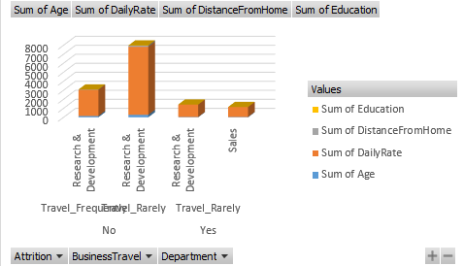
RESULTS
11

Slide 12

conclusion

